Slide 1

SUMMIT BANK
BY: ASHOK, ABBAS, ABSHAAR, SIDHARTH, SAHIB, RAMAN

Slide 2

Ashok’s code

Slide 3
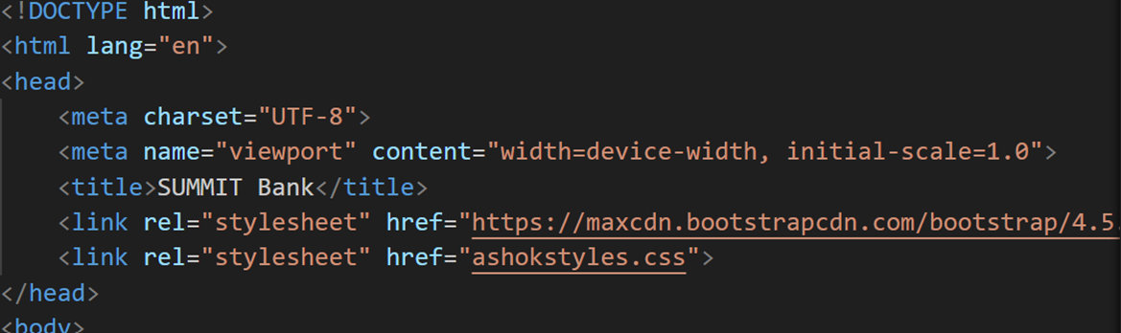
Key Feature: HTML Document Structure
Meta Tags: Defines character set and viewport settings.
Title: Sets the title of the webpage to "SUMMIT Bank".
Stylesheets: Links to Bootstrap for responsive design and a custom stylesheet (ashokstyles.css).

Slide 4
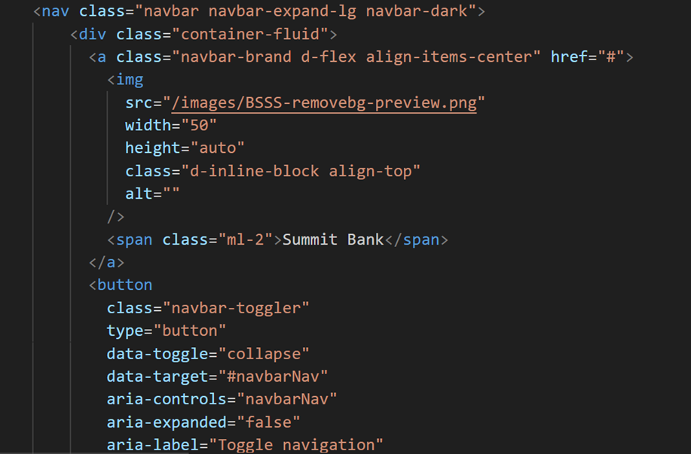
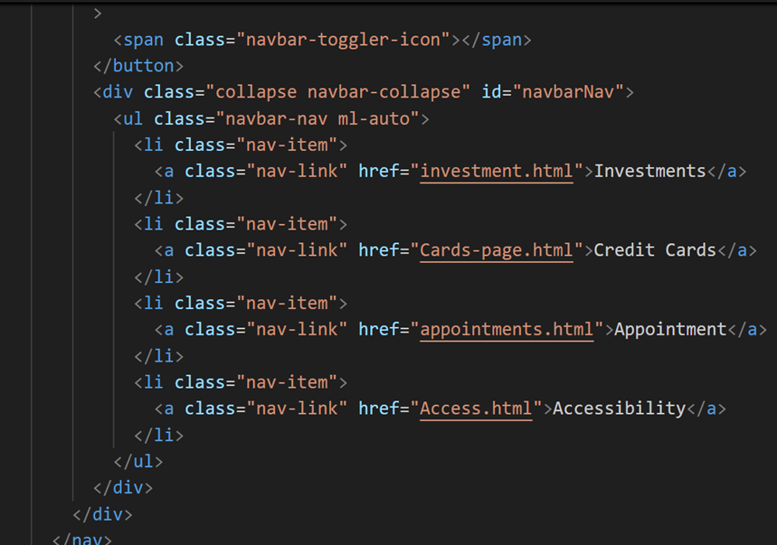
Key Feature: Navigation Bar (HTML)
Uses Bootstrap classes to create a responsive and dark-themed navigation bar.
Logo and Brand: Includes an image and the bank's name.
Navigation Links: Links to different sections like "Investments," "Credit Cards," "Appointment," and "Accessibility".
Responsive Toggle Button: Allows collapsing the menu on smaller screens.

Slide 5
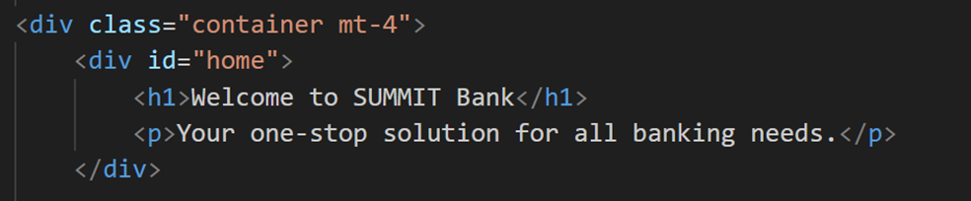
Key Feature: Main Content (HTML)
Welcome Section: A welcoming message introducing SUMMIT Bank.
Investment Options: A grid layout (using Bootstrap's grid system) showcasing different investment products (TSFA, GIC, RRSP) with images and descriptions.
Account Types: Another grid layout detailing various account types (Checking Account, Saving Account, Money Marketing Account) with images and descriptions.

Slide 6
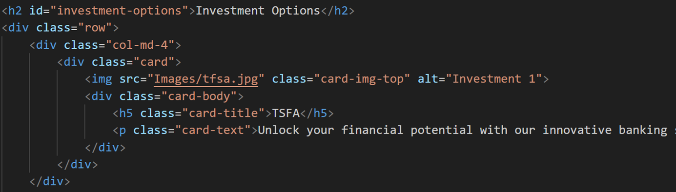
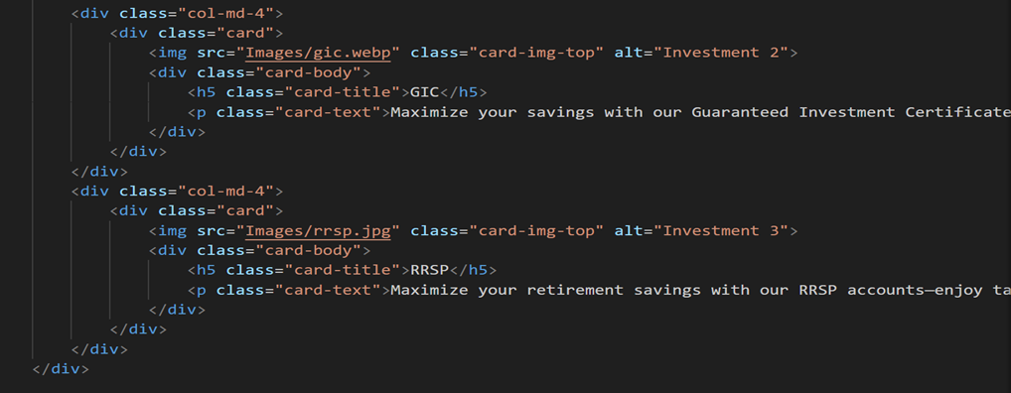
Key Features: Investment Options (HTML)

Slide 7
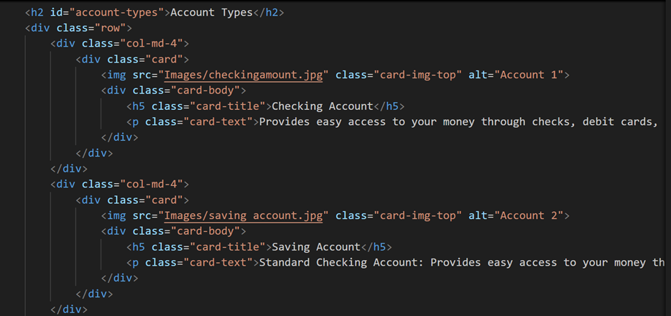
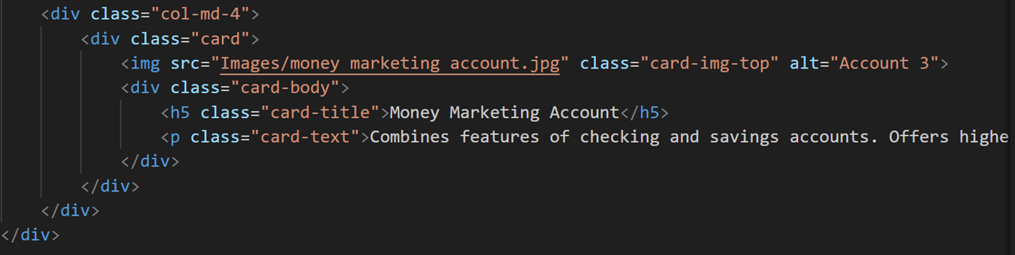
Key Features: Account Types (HTML)

Slide 8
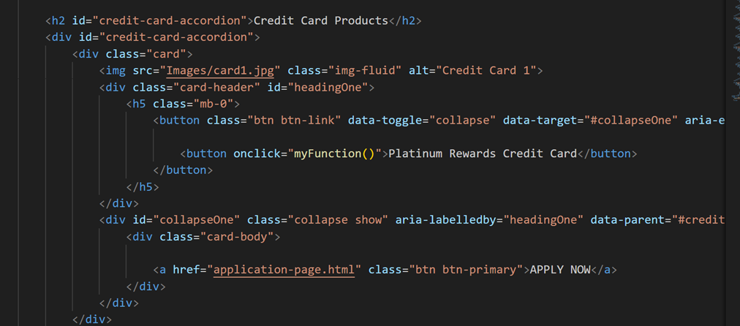
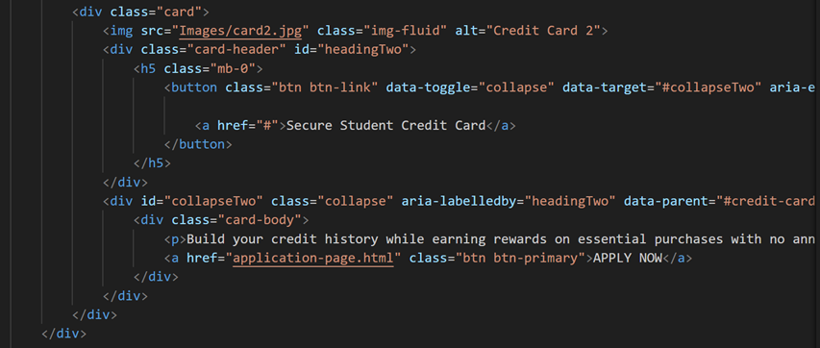
Key Features: Credit Card Products (HTML)
Uses a collapsible accordion to display credit card options.
Card Details: Each card includes an image, a title, a button to reveal more information, and a link to apply.

Slide 9
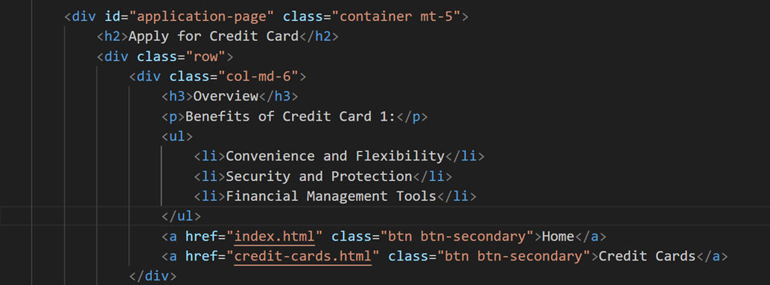
Key Features: Application Page (HTML)
Overview Section: Provides an overview of the benefits of the credit card and navigation buttons to return to the home or credit card page.

Slide 10
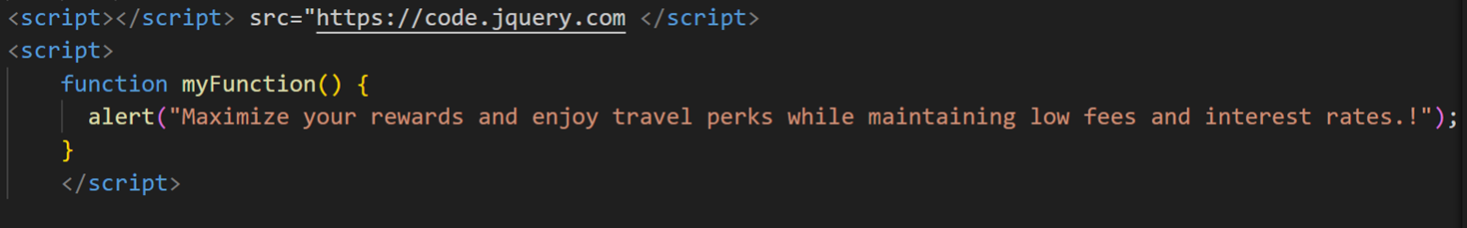
Key Features: Javascript Function
A custom script for a function (myFunction) that triggers an alert message when a button is clicked.

Slide 11
Key Features: Javascript Function

Slide 12
Abbas’s Code

Slide 13
Appointments Page
Abbas al

Slide 14
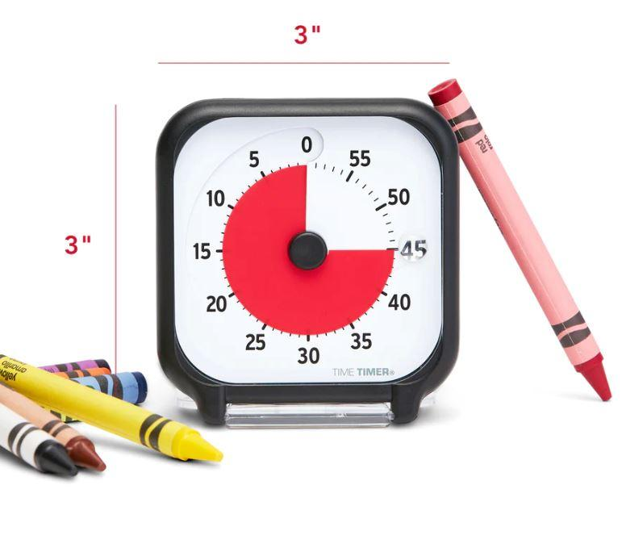

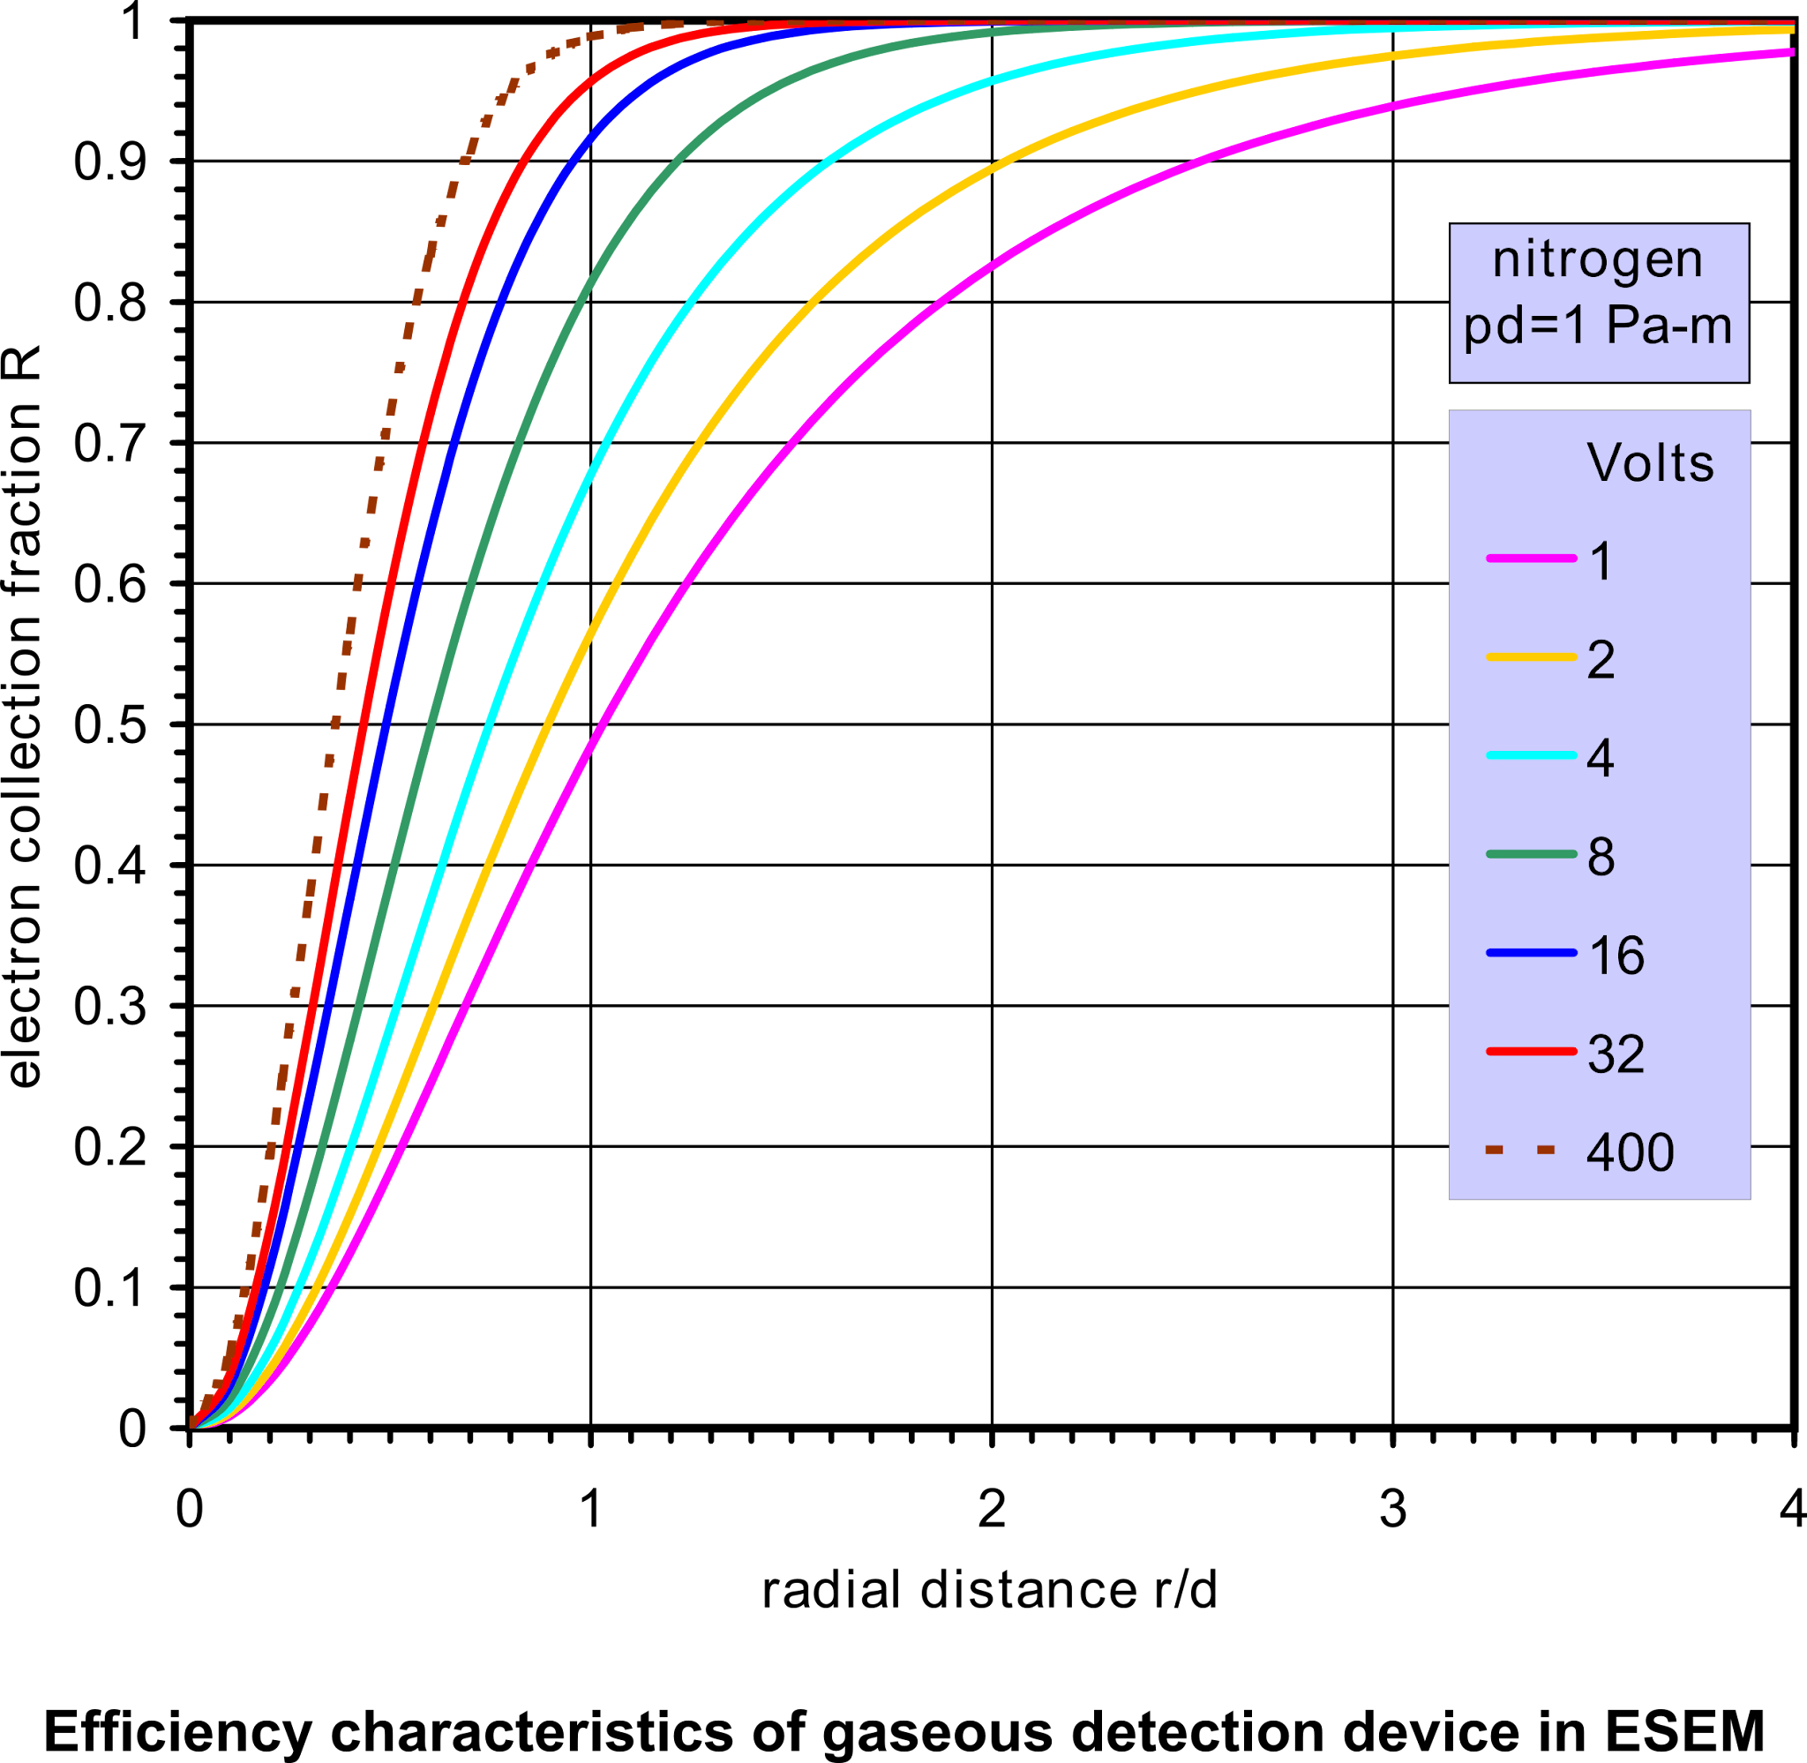
Why Create An Appointments Page?
-Client Convenience
-Competitive Advantage
-Efficiency for Advisors

Slide 15
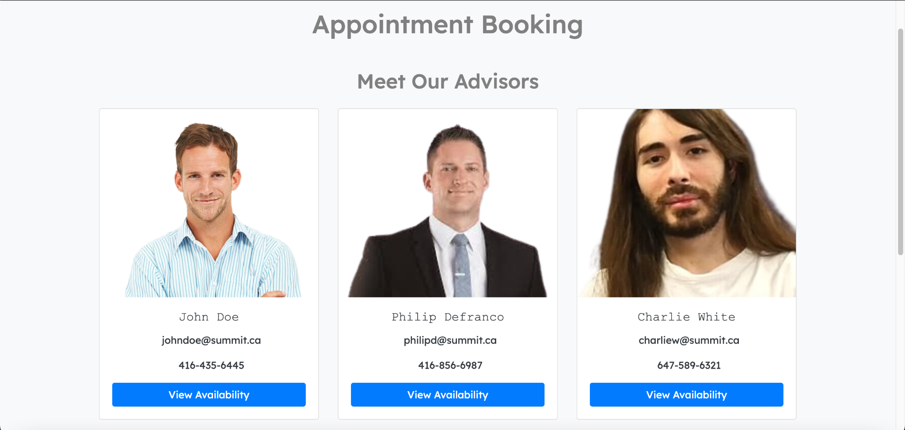
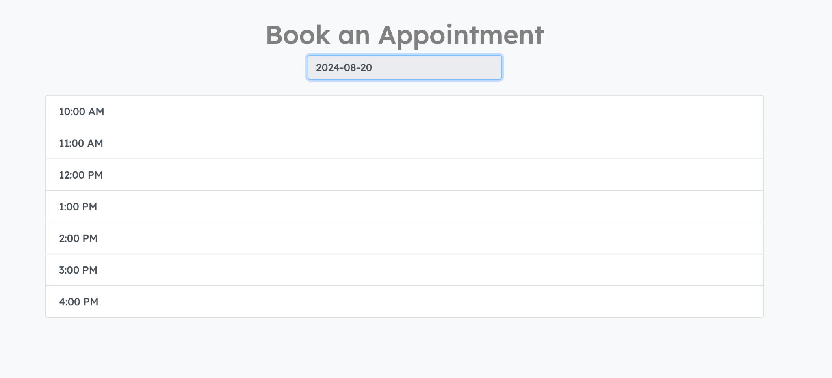
Solution Overview
Interactive Appointment Booking→
← Real Time Availability

Slide 16
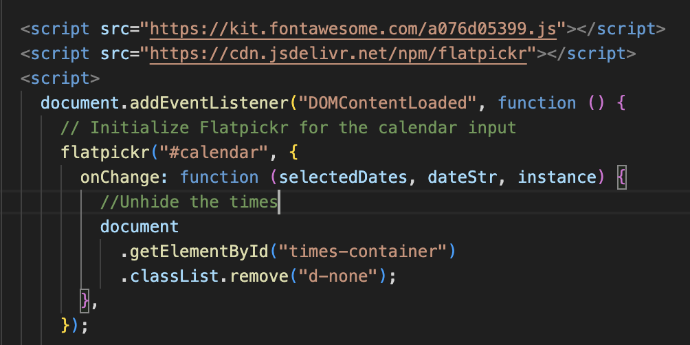
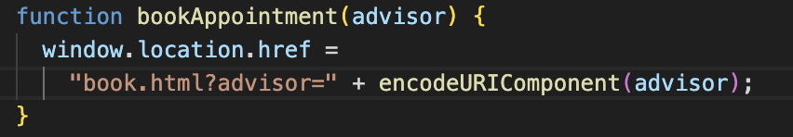
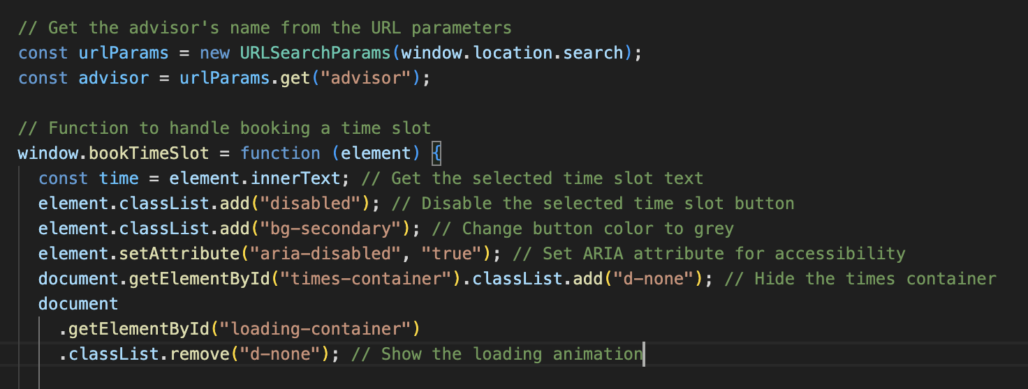
Technical Highlights
-Importing Calendar using Flatpickr
- Creating a html container to hold the calendar
-Using javascript functions to create a dynamic response
-Creating a function that stores advisors name in the url
-Extract advisor name from the url
-Extract selected time
-Simulate a loading screen so user knows appt is booked

Slide 17
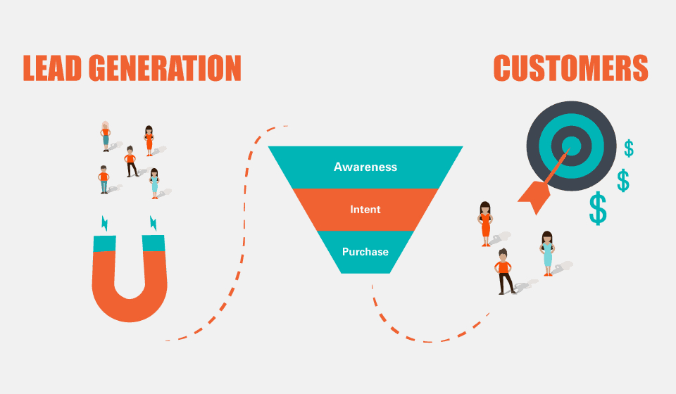
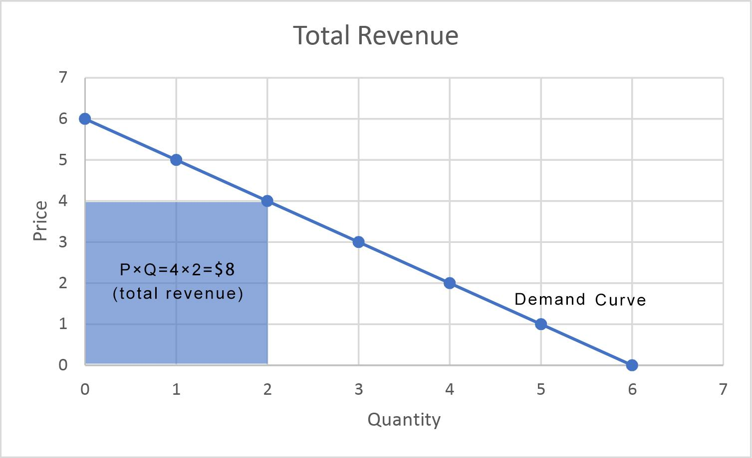
Market Potential
-New stream of lead generation for businesses
-Revenue Opportunities
-Can be rebranded and used by anyone

Slide 18
Sahib’s CODE

Slide 19
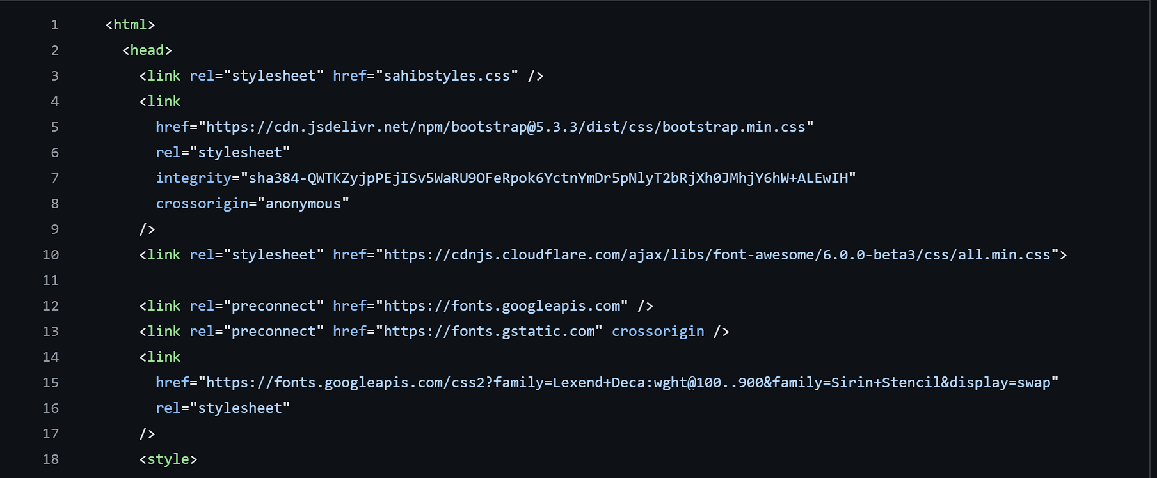
HTML Structure has three structures:
Head, Body and Footer
Head Section has three main Functions:
Linking Stylesheets, Fonts and Icons
Google Fonts used: Lexend Deca

Slide 20
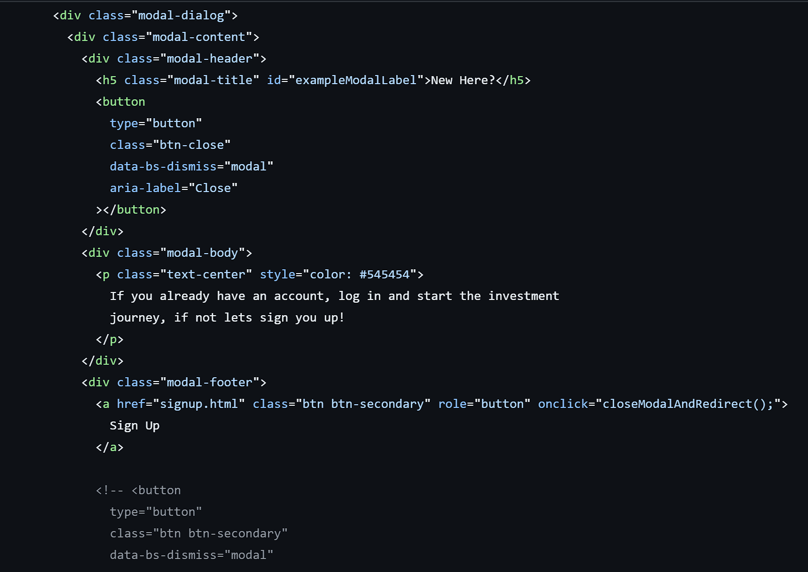
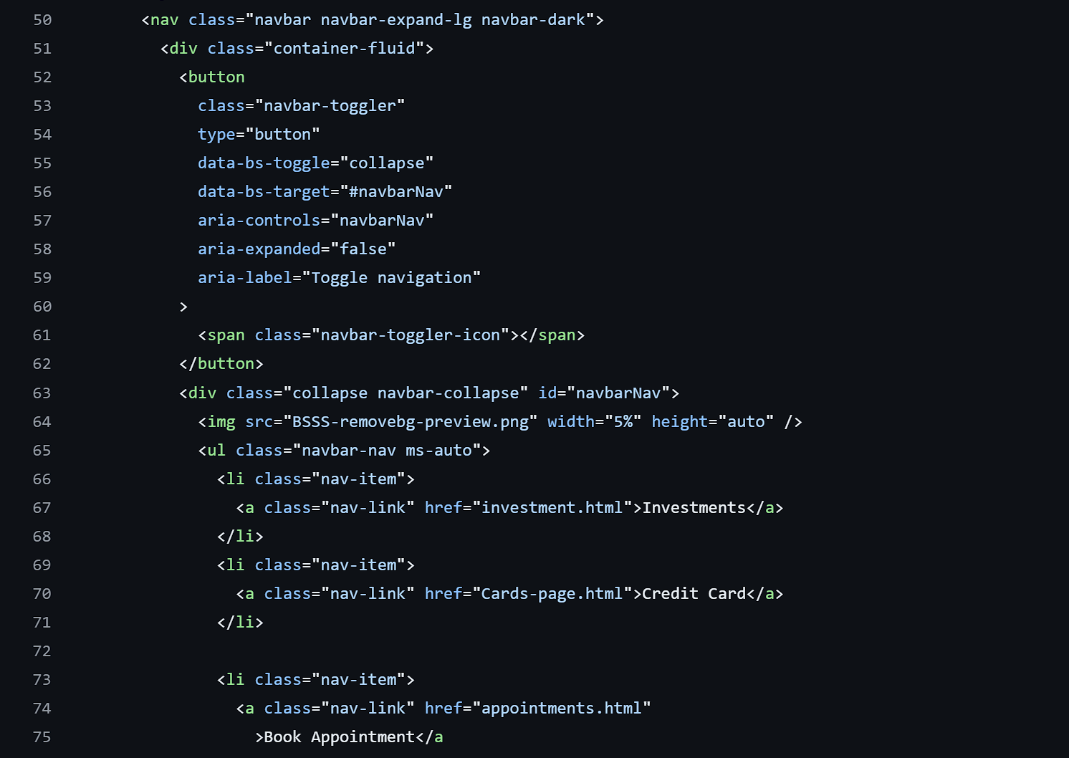
Investments page
It has Following main elements:
1. Carousel
2. Sign Up Button
3. Arrow-Buttons
4. SVJ File
5. Image Cards

Slide 21
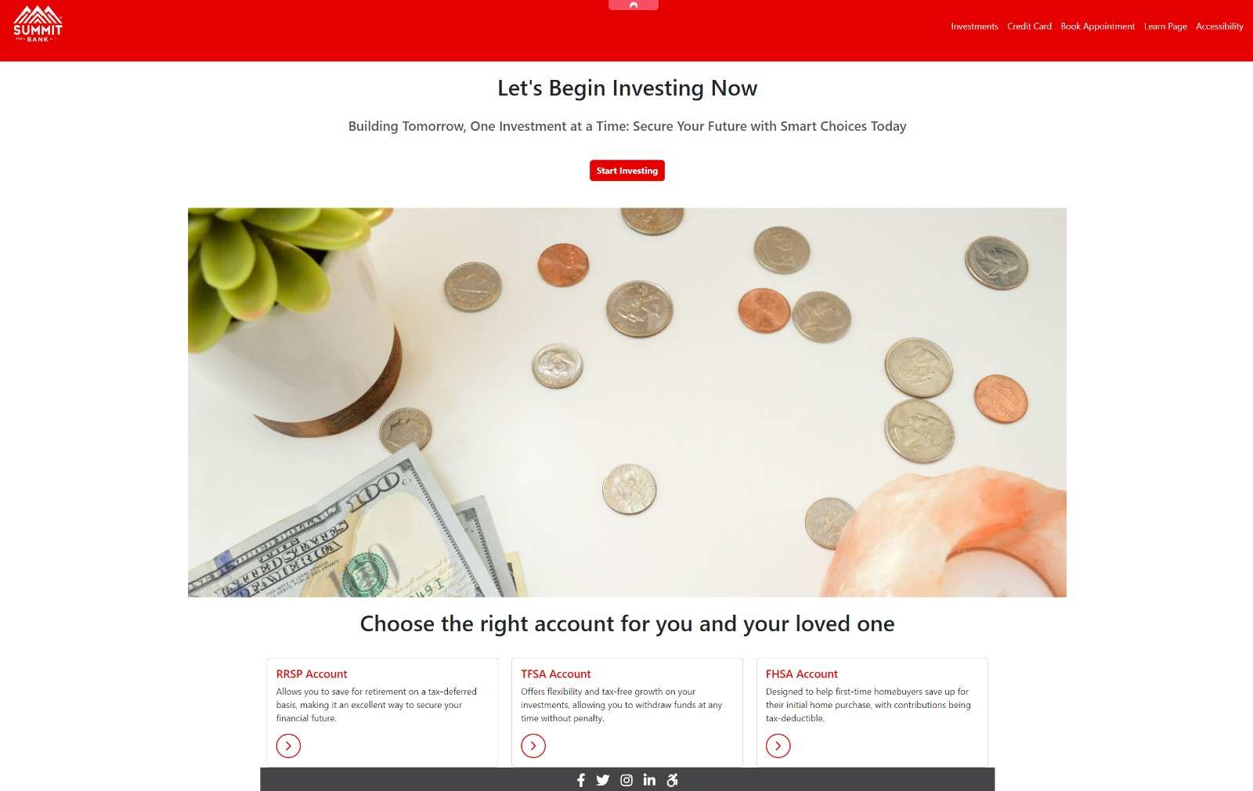
Investments page

Slide 22
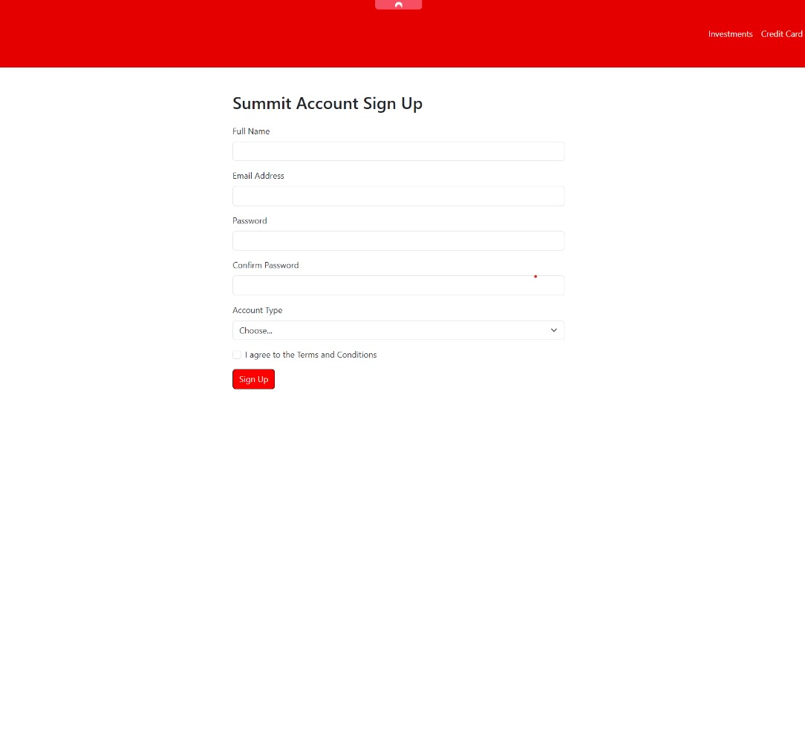
Sign UP PAGE
Input Text Feedback Form
Check the box for selecting
Sign Up Button
Script for Feedback when Clicked

Slide 23
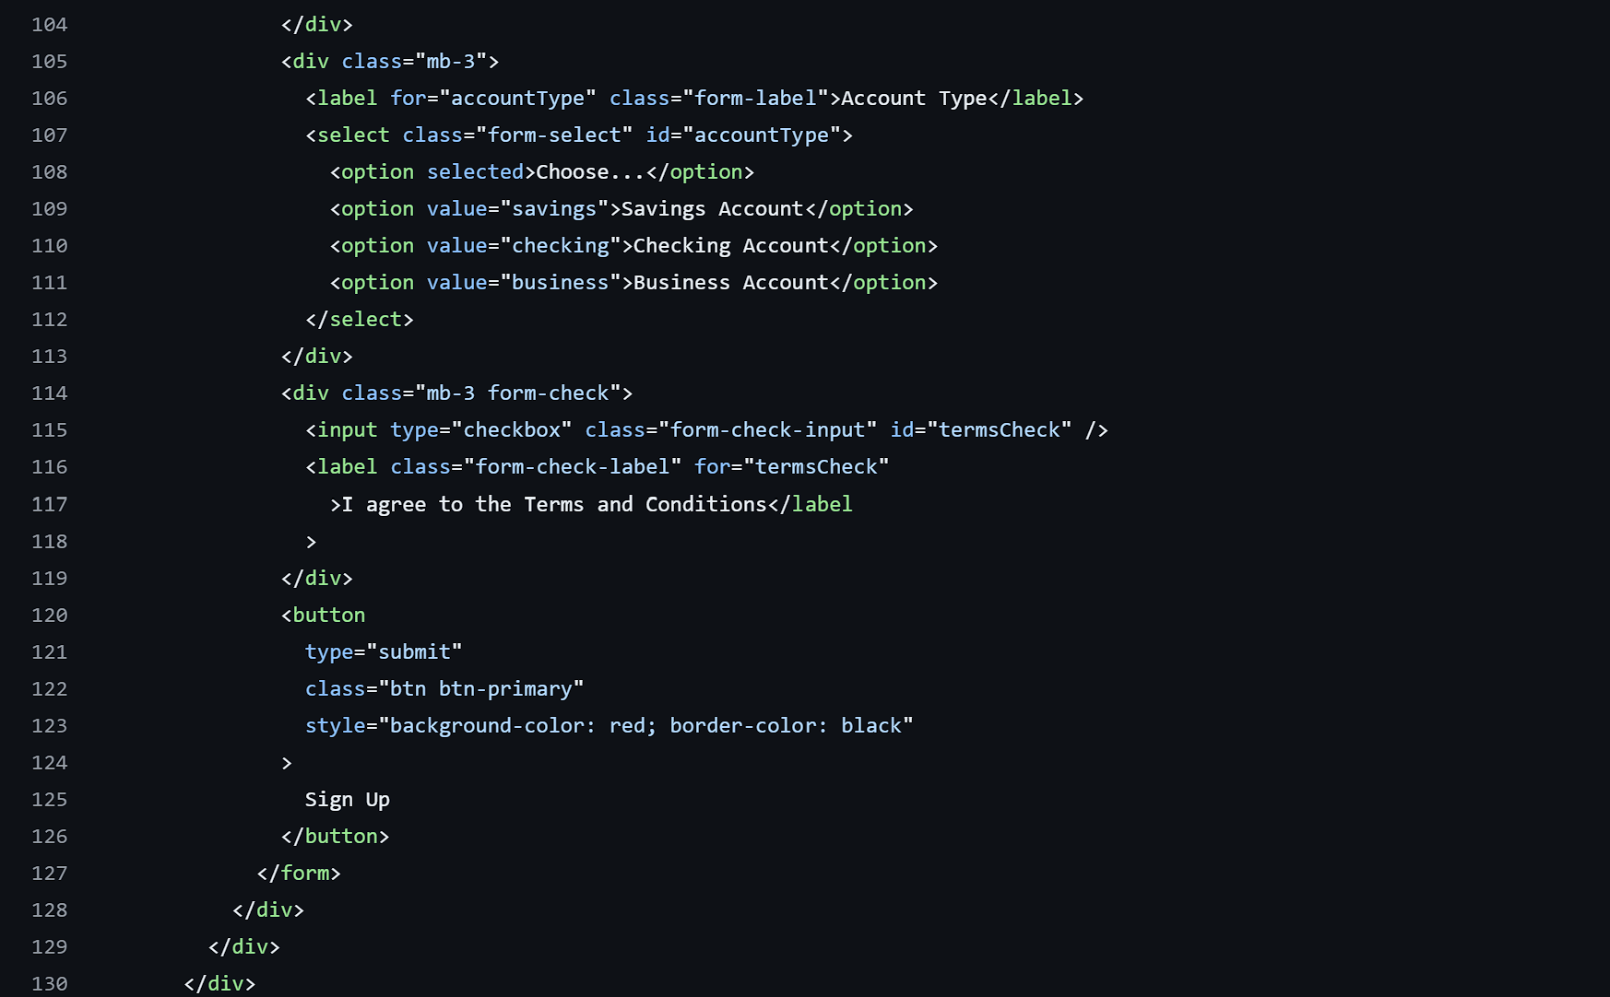
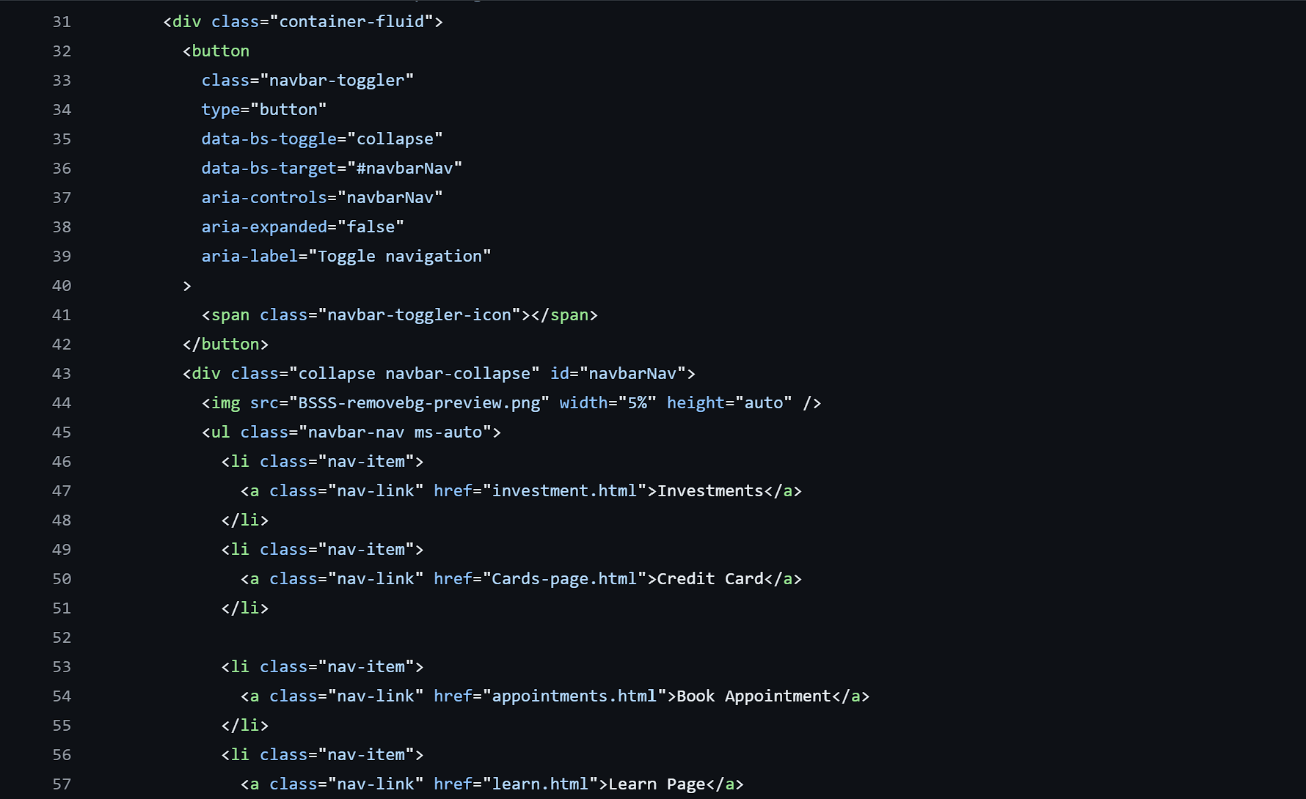
SIGN UP PAGE SNIPETS
Code Highlights

Slide 24
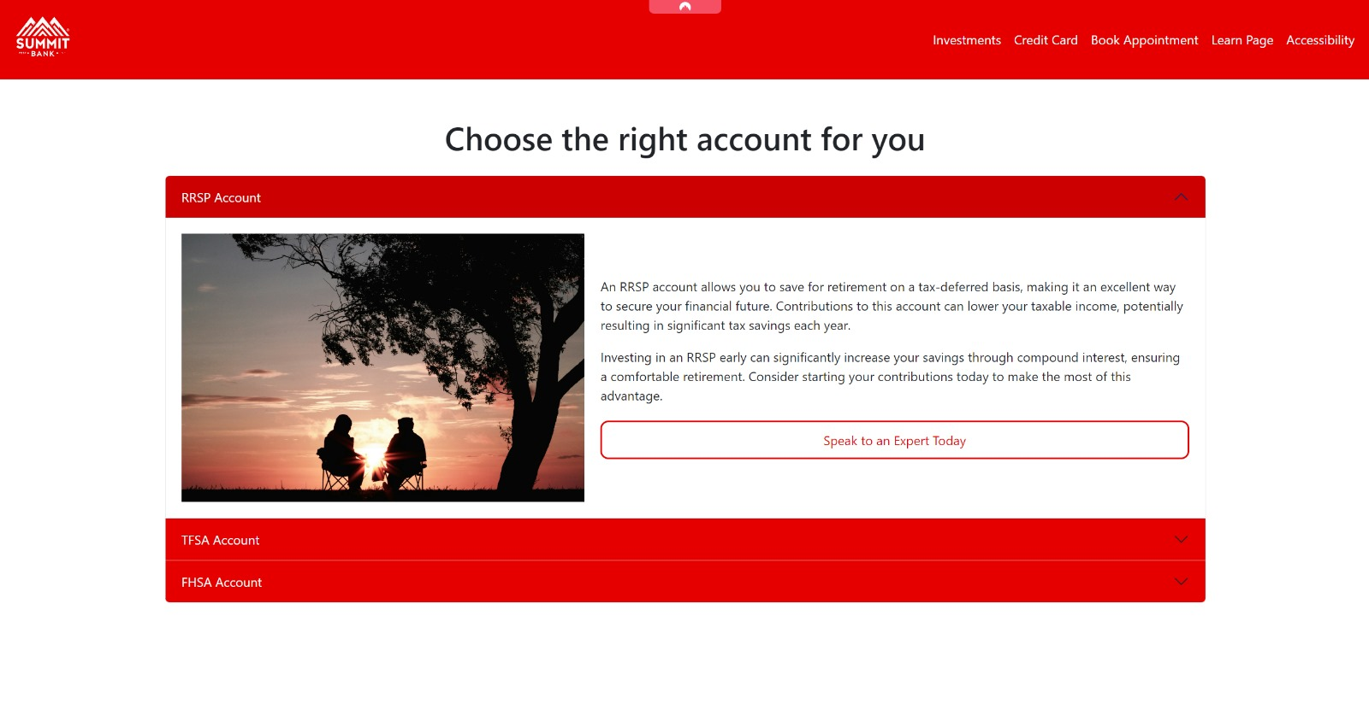
Accounts page

Slide 25
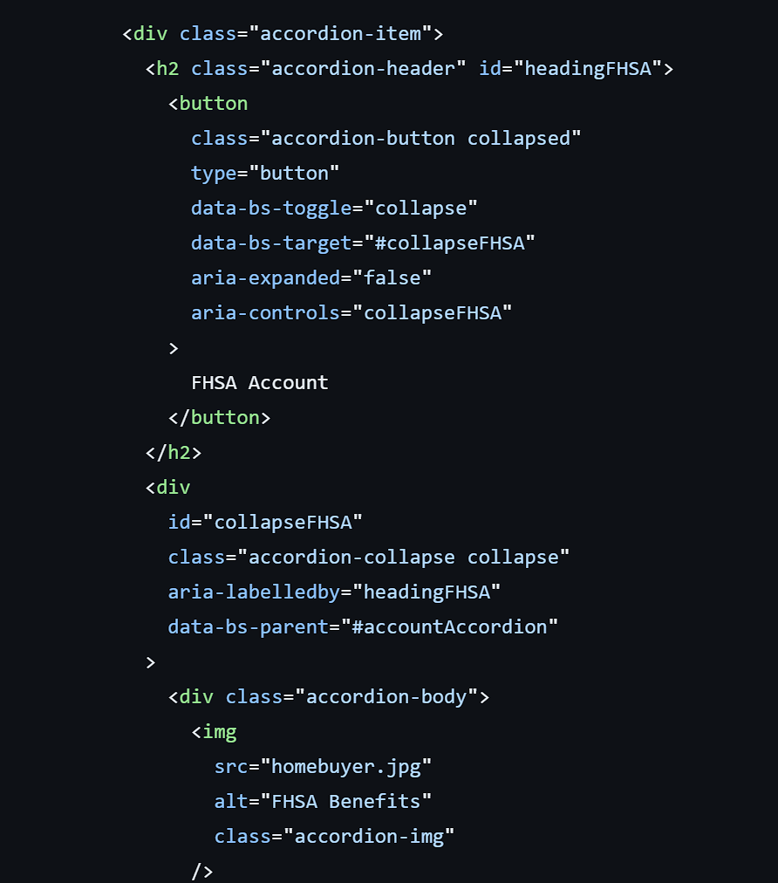
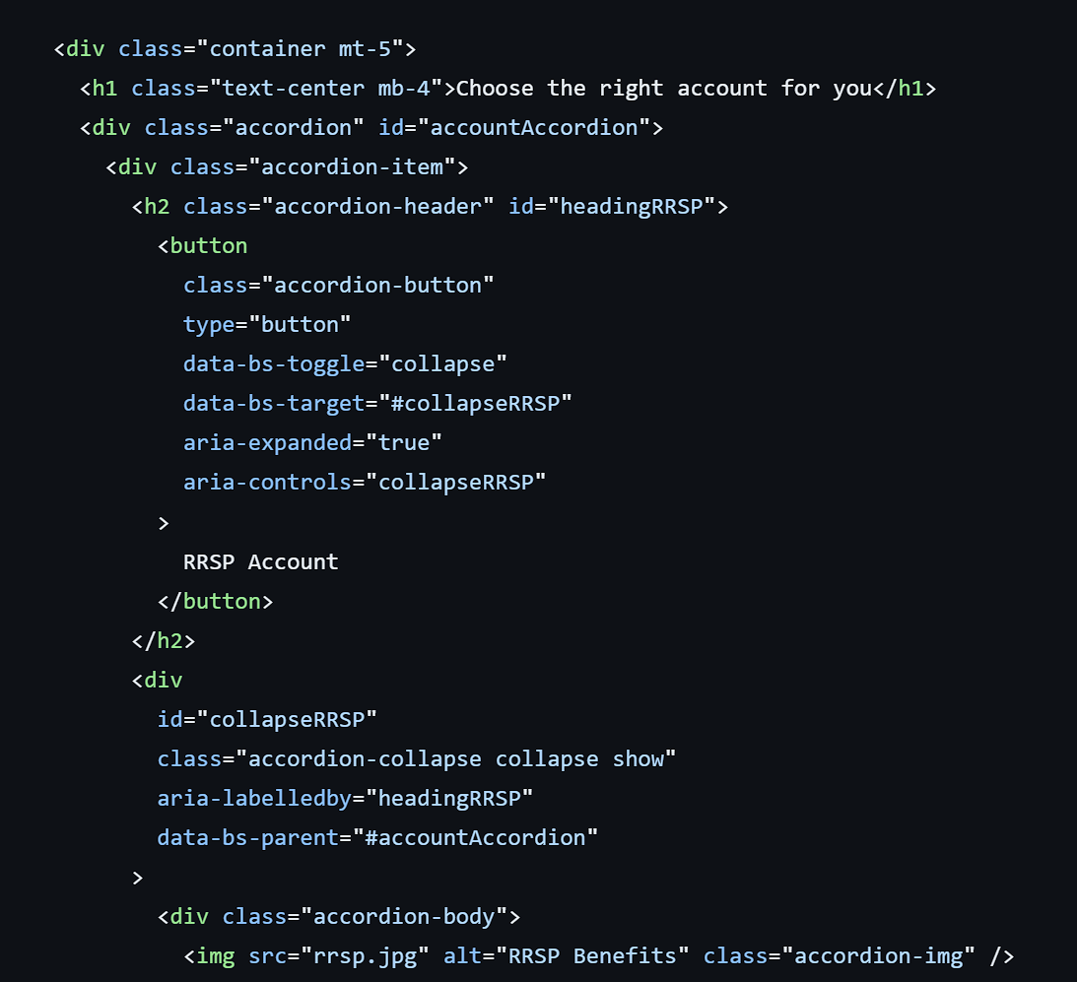
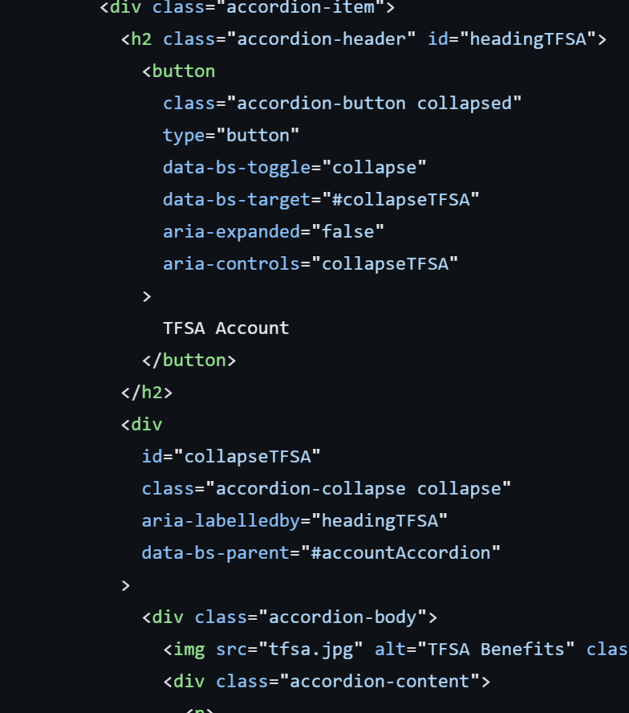
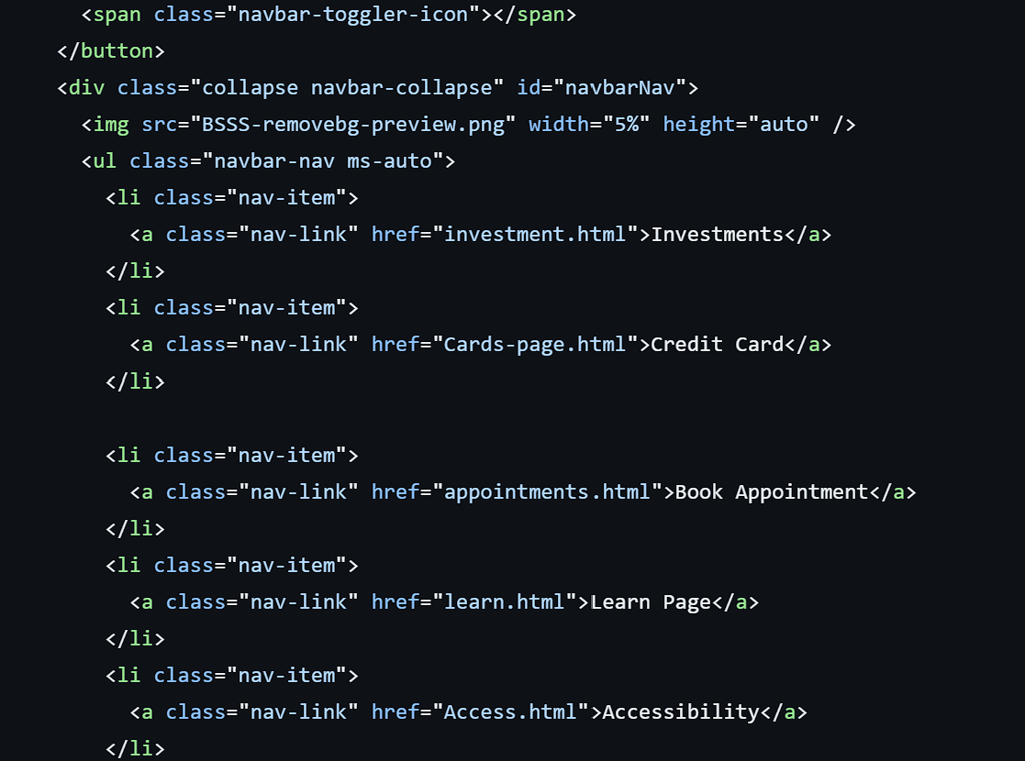
Accounts page snippets
Code Highlights

Slide 26
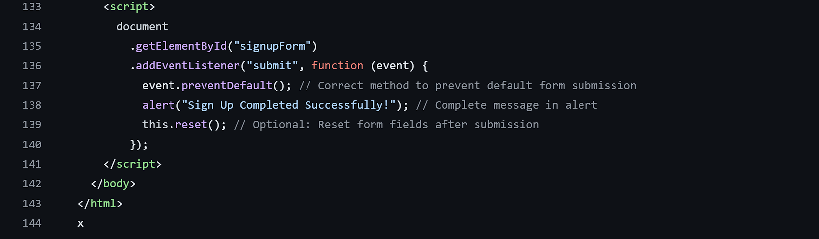
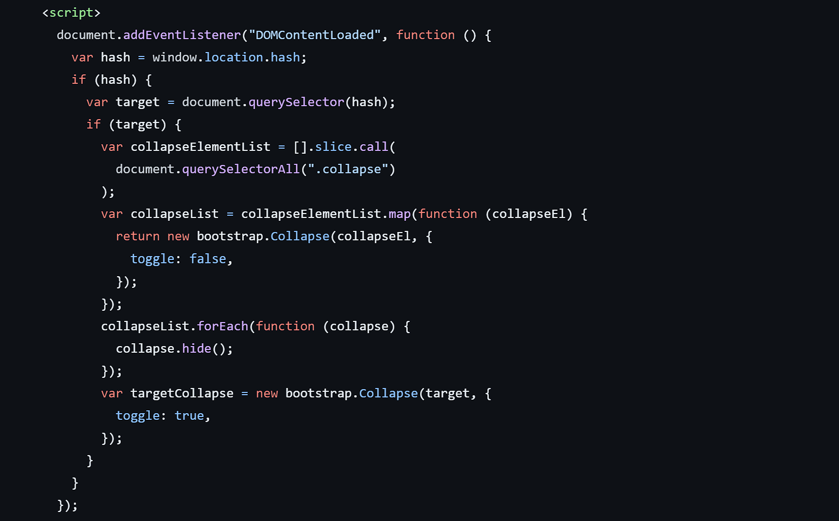
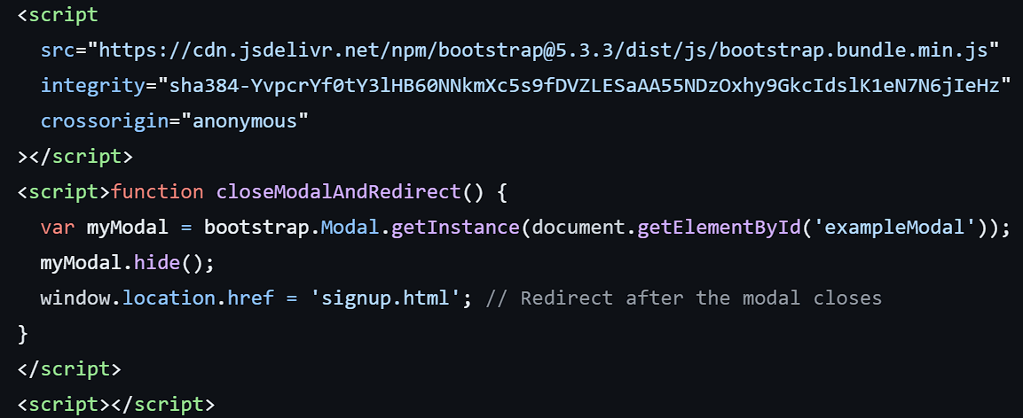
JAVA-SCRIPT FUNCTIONALITY
JavaScript Functionality:
Use addEventListener
Use CloseModalAndDirect:
Use QuerySelector

Slide 27
SID’S CODE

Slide 28
Credit Card Page
By - Sidarth

Slide 29
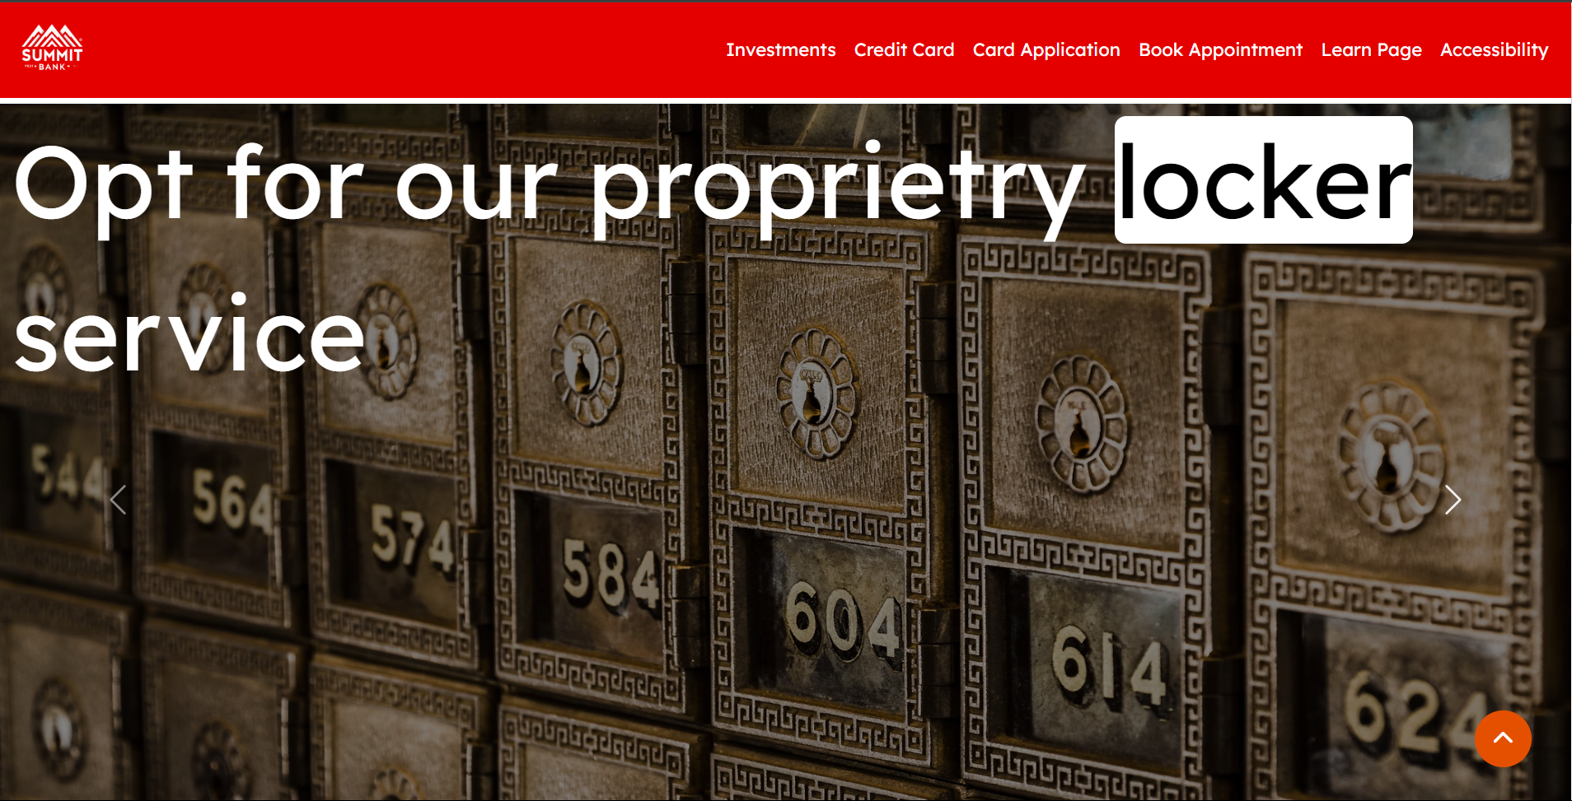

Slide 30
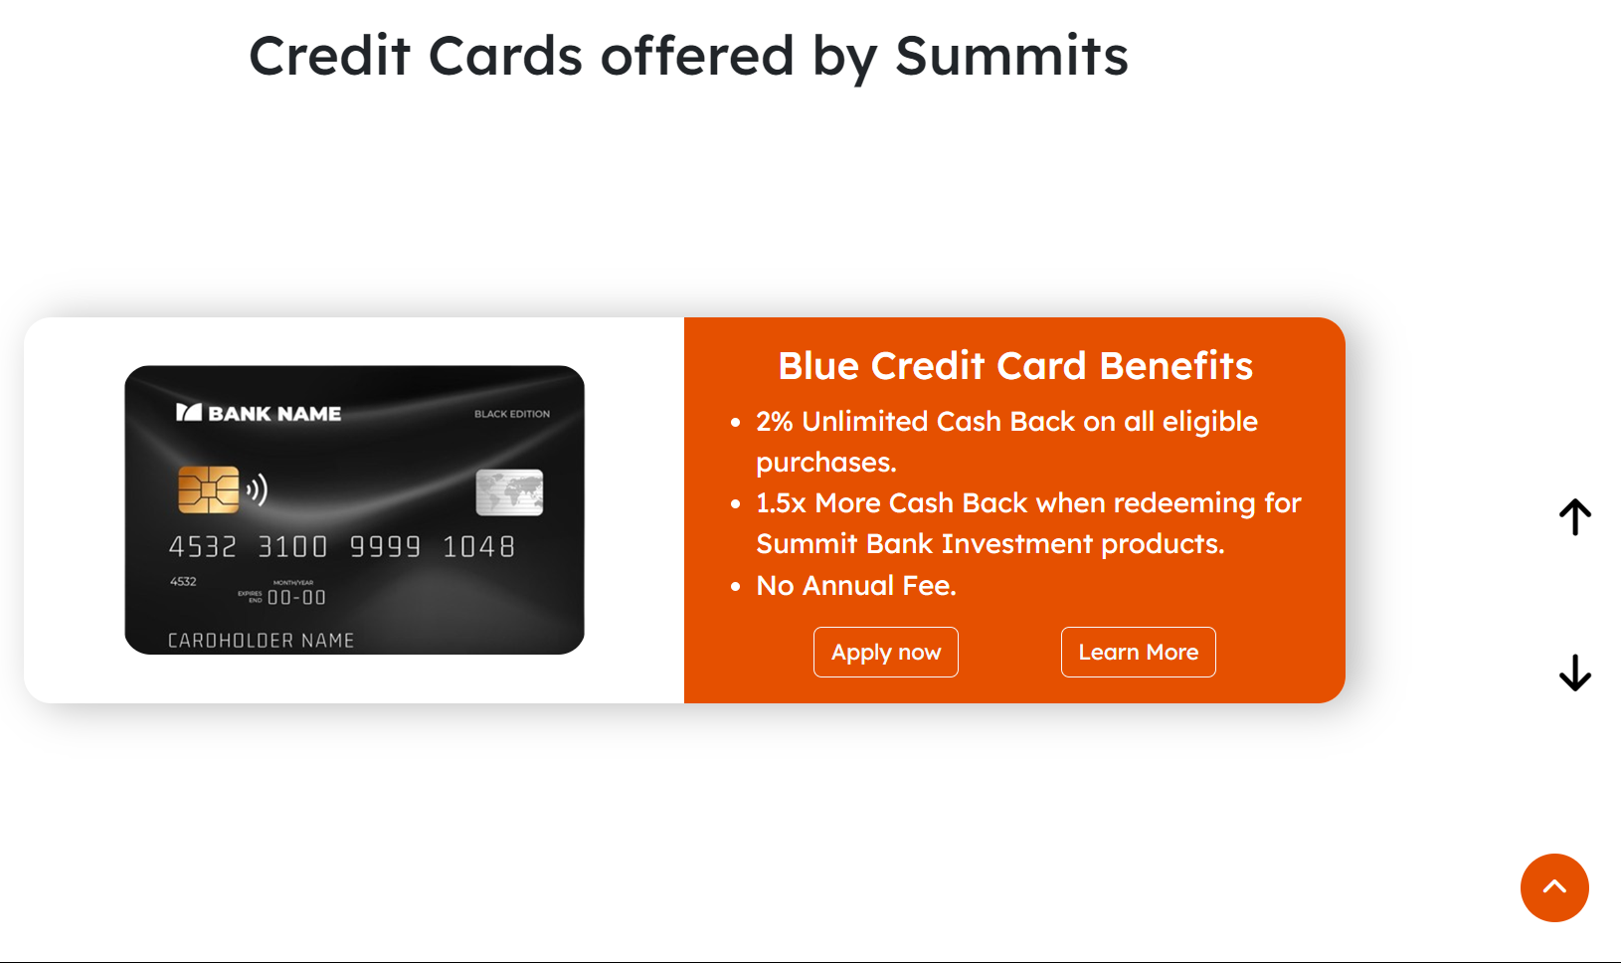
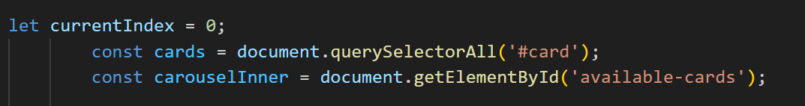
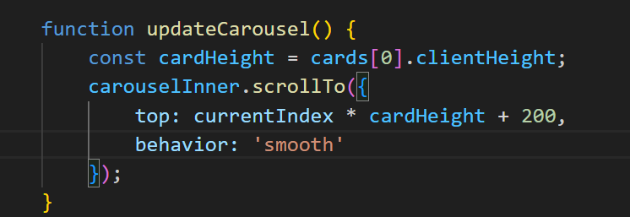
Toggle – buttons to switch from current card to next one or previous one

Slide 31
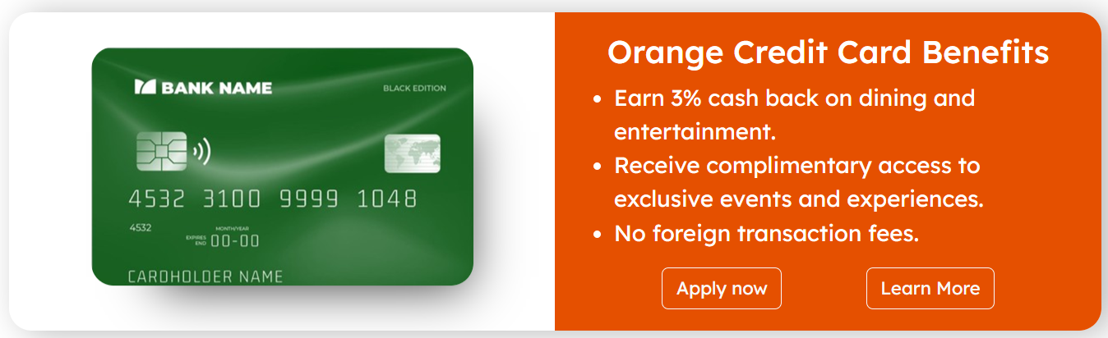
Card images with hover styling
Hyperlink buttons made using a tags

Slide 32
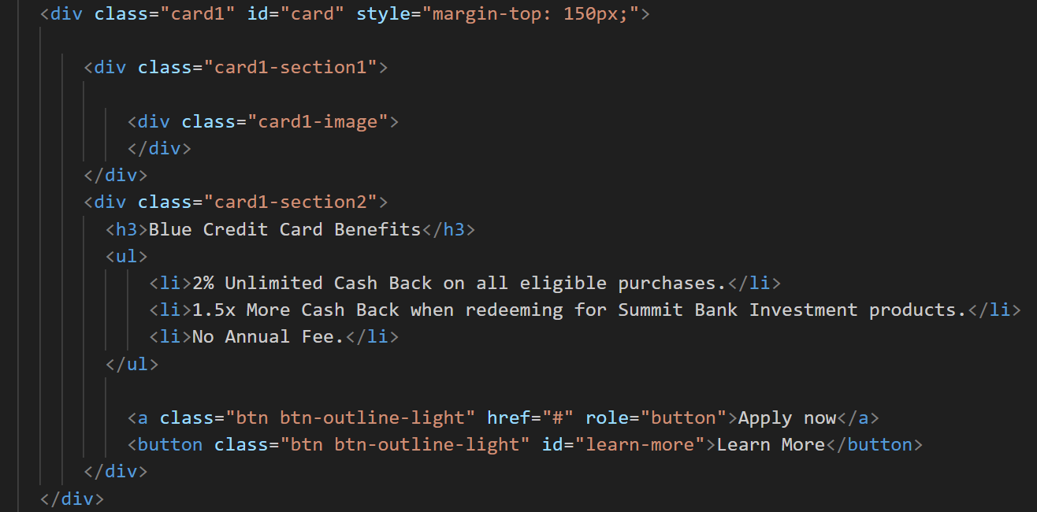

Slide 33
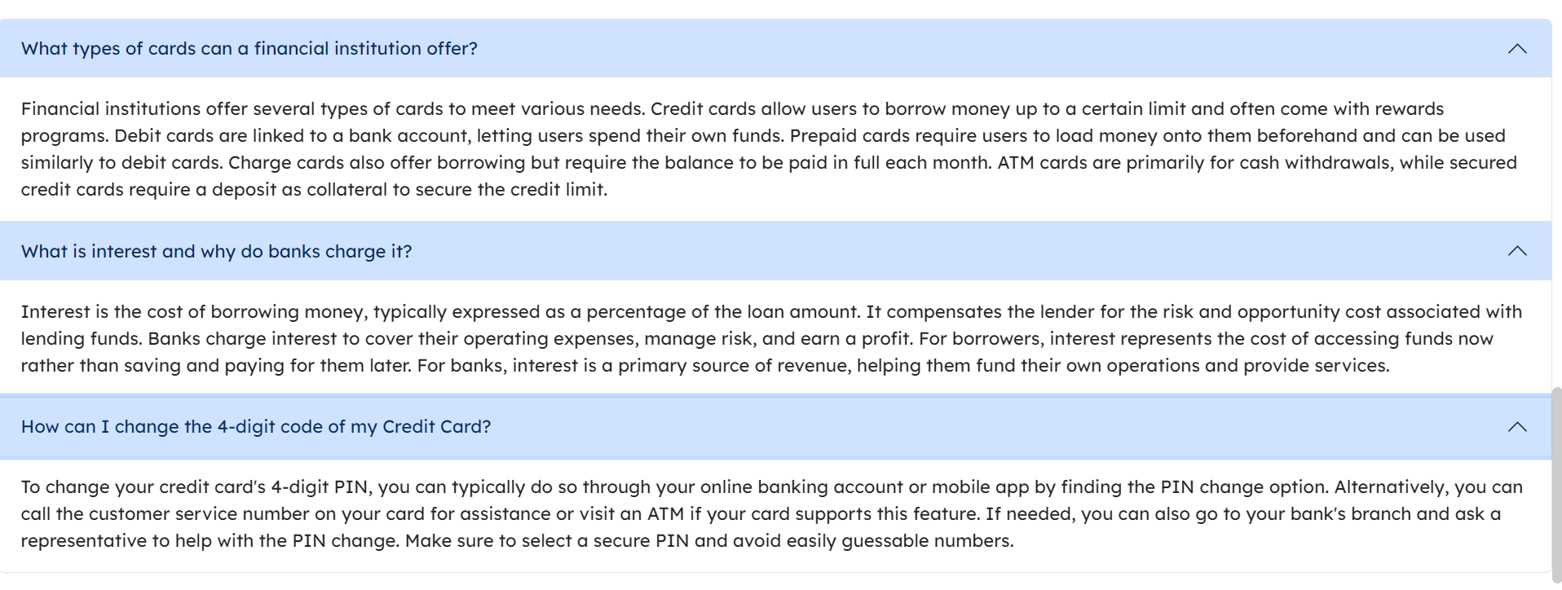
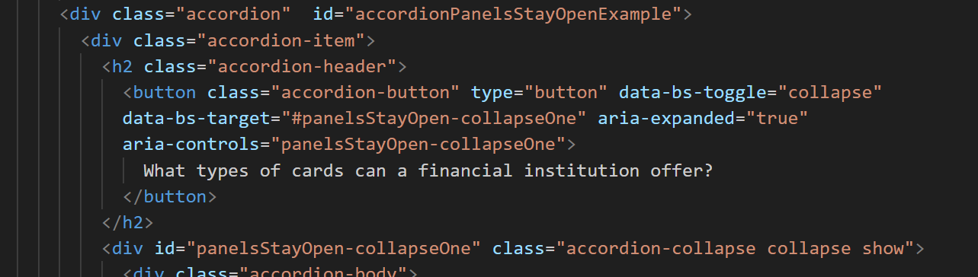
Bootstrap – Accordion Class

Slide 34
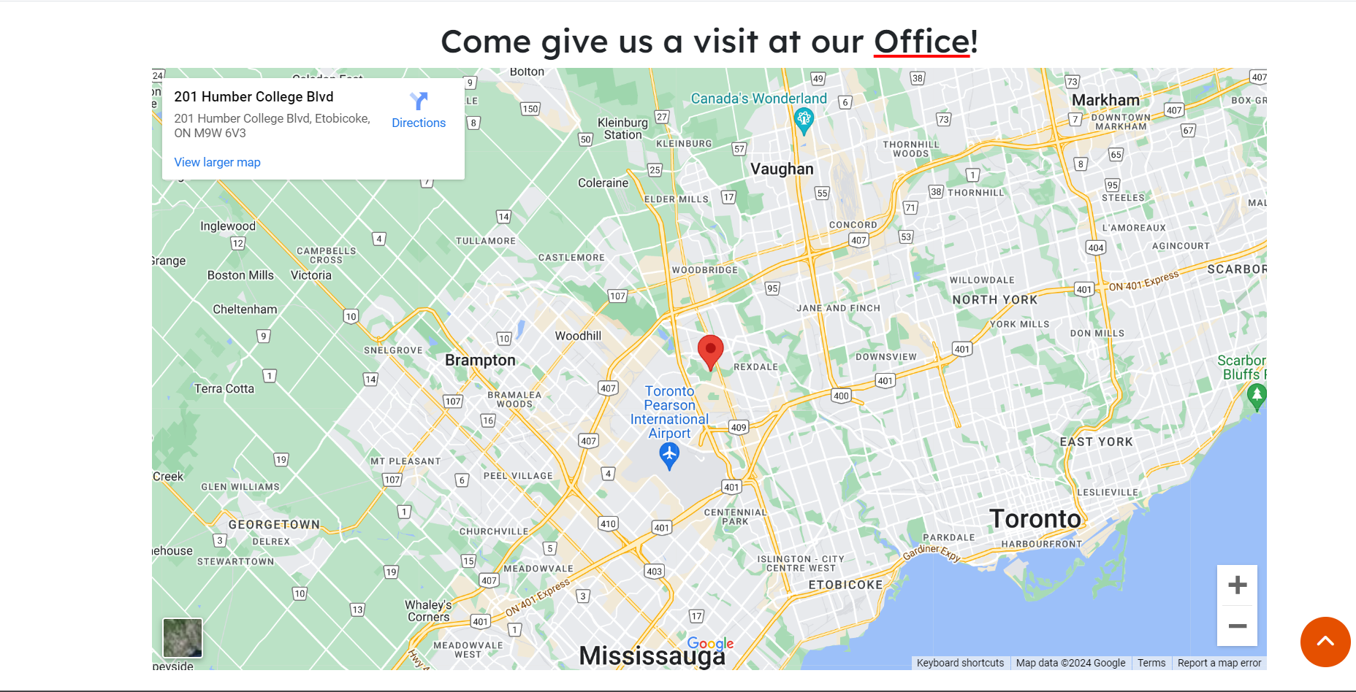
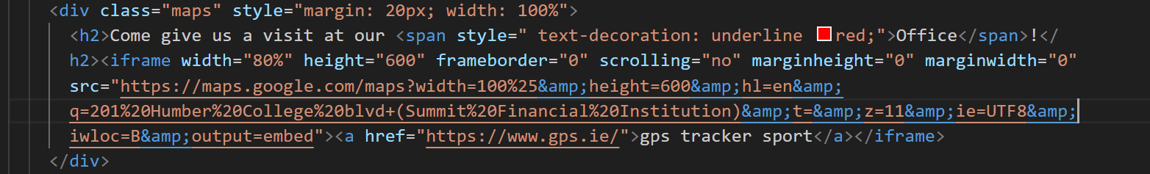
Iframe Google maps

Slide 35
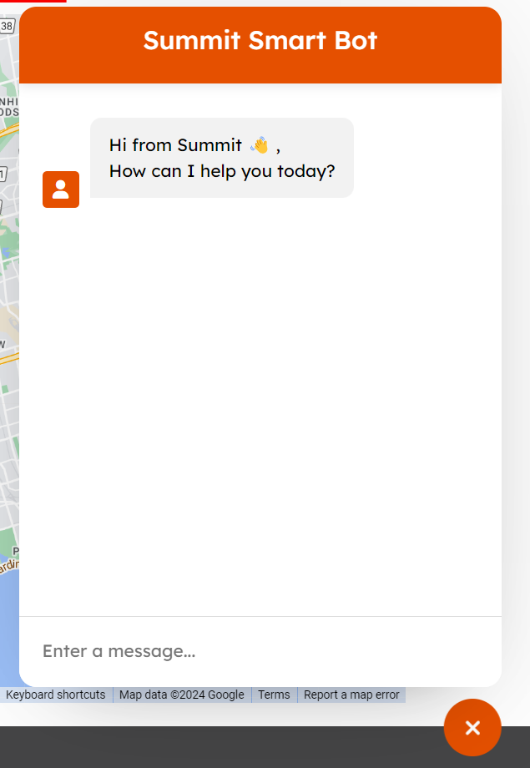
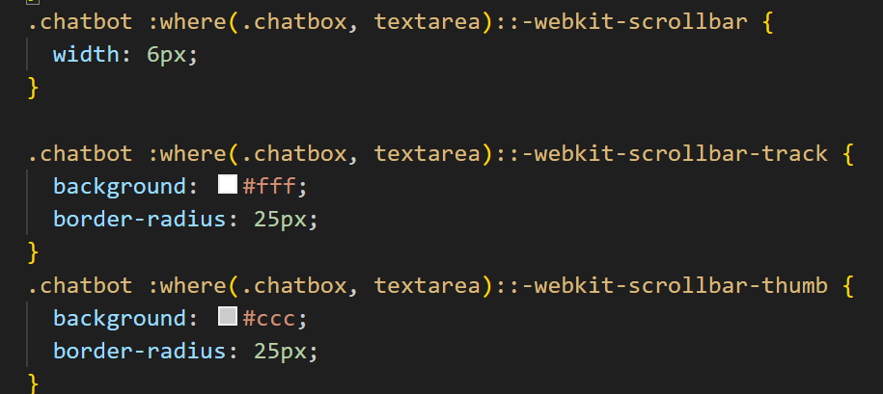
Summit Smart Bot
Targets the entire scrollbar
Targets the scroll track of webpage
Targets the thumb of the scroll track

Slide 36
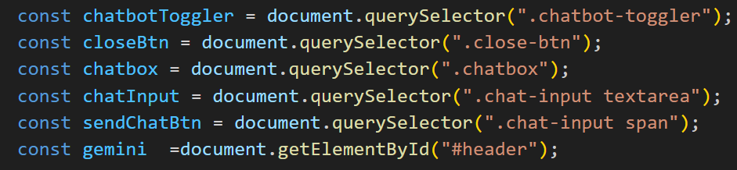
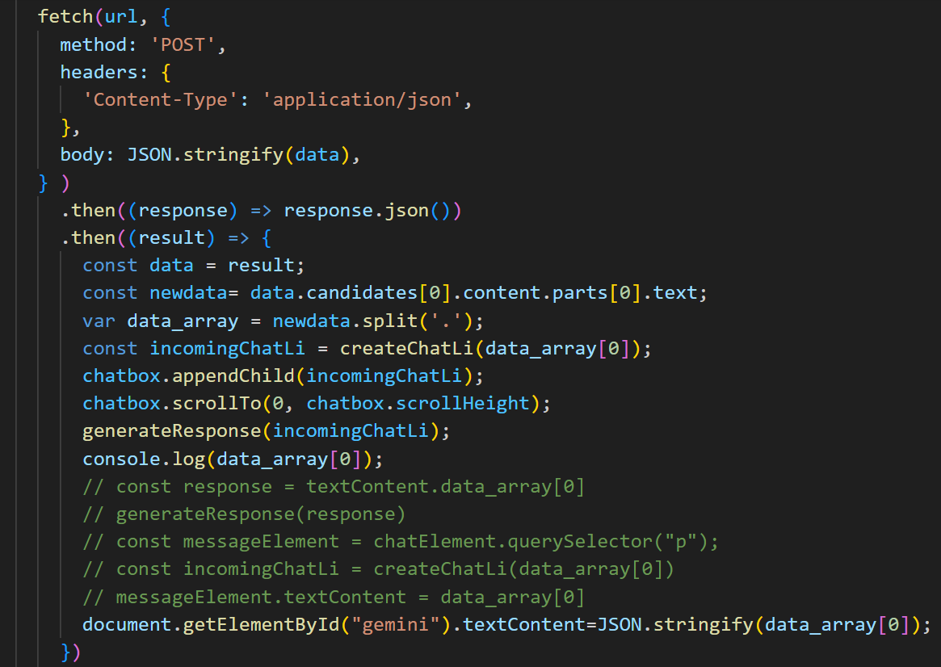

Slide 37
Raman’s Code

Slide 38


CARD APPLICATION
&
ACCESSIBILITY PAGE

Slide 39

Body Section
It has two main elements:
1. Header
2. Main Content
Main Content has two Sections:
Right Panel
Left Panel

Slide 40

Body Section: Left panel
Left Panel: Card Info and Benefits: Section where information about the credit card and its benefits is displayed.
Navigation Icons: Explain the icons that link to other pages like home and back.

Slide 41

Body Section: Right panel
Right Panel Form: Explain that the main interaction on the page is through a form for applying for the card.
Progress Bar: Describe how the progress bar visually indicates the user's progress through the form.
Questions: Explain how the form is divided into multiple steps or questions, making it easier for the user to complete the application.
  Buttons: Explain the buttons for navigating between questions and submitting the form.
Submission and Processing: Describe what happens when the form is submitted, including the display of a progress bar and a confirmation message

Slide 42




Slide 43

Footer section and java-script functionality
Footer Section:
Social Media Links: Explain that the footer contains links to the bank's social media pages, making it easy for users to connect with the bank online.
JavaScript Functionality:
Progress Bar Update: Explain how the progress bar updates as the user moves through the form.
Navigation Functions: Describe the JavaScript functions (nextQuestion and prevQuestion) that handle moving between form steps.
Form Submission: Explain the handleSubmit function that simulates form submission and shows a processing message followed by a confirmation.

Slide 44

Accessibility page
Use of Bootstrap
Element uses NAV Bar with drop-down
Added text box with statements
Added a form for feedback
Submit button that prompts a message

Slide 45


Styles highlights
Text Input box styling
Progress Bar styling
Nav Icons styling
Feedback form styling

Slide 46

Thank you for listening

